Slide 1
Sudanese diaspora:
Migration & Settlement in the united States
By: Meve Lako

Slide 2
Since the beginning of time, humans have migrated in search of safety, opportunity, and a better life. For many, this journey means leaving everything familiar behind to escape religious persecution, genocide, famine, and conflict. I come from one of these war-torn countries, and my family and I were forced to flee in search of safety and a better future.

Slide 3
Motivation
This project is personal for me. My own journey began in Sudan, moved through Egypt, and finally brought me to the U.S. I wanted to use data to see how my story fits into the larger picture of the thousands of others who have made similar journeys. This project examines displacement patterns from 2001 to 2024 and focuses on how many Sudanese have been displaced. I set out to answer three main questions: How many people are coming? What is their legal status? And most importantly, where are they choosing to rebuild their lives today?

Slide 4
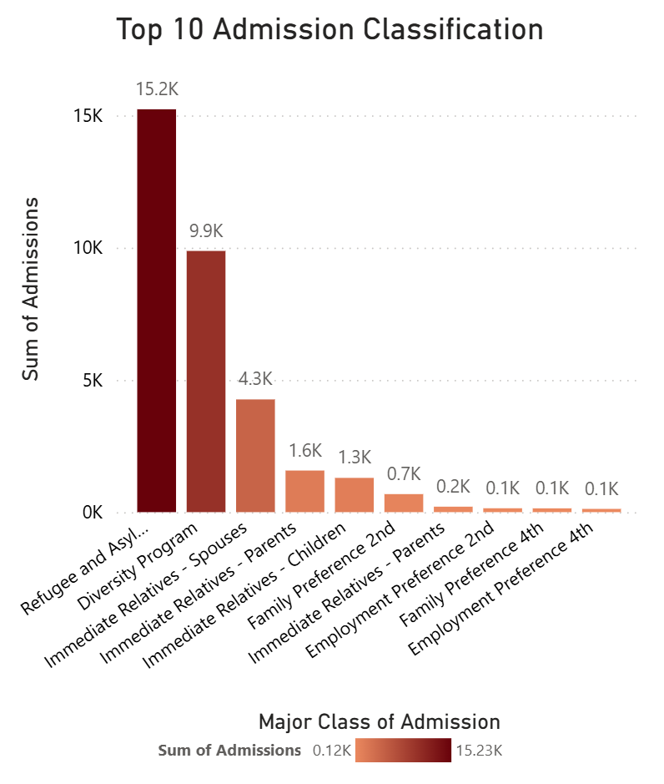

Slide 5
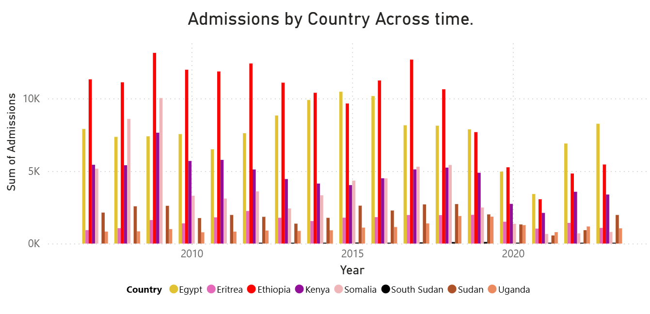
When we look at this graph, we see that migration is never a straight line.It happens in waves.

Slide 6
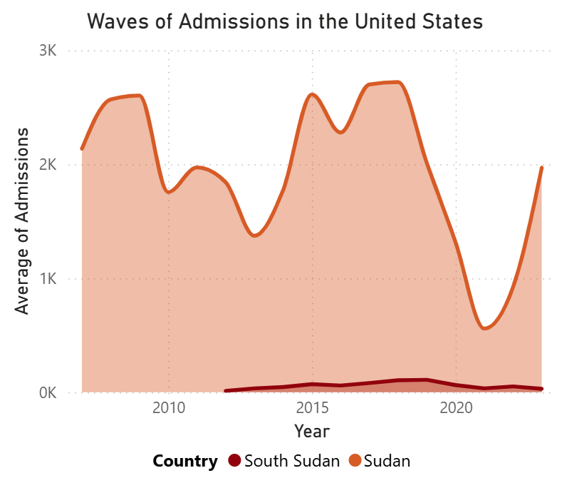

Slide 7
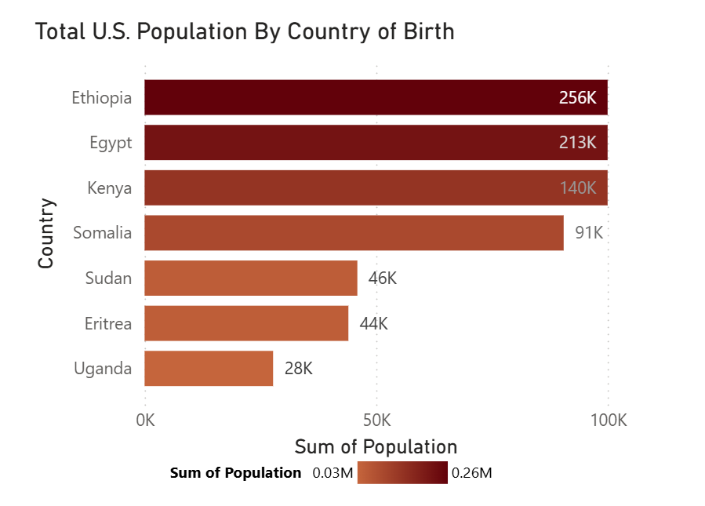
Although Sudan compared to its neighbors is very small, its represents 46,000 people.

Slide 8
From this map view, Texas, Tennessee, Virginia, and New York are the leading states for entering settlers.

Slide 9
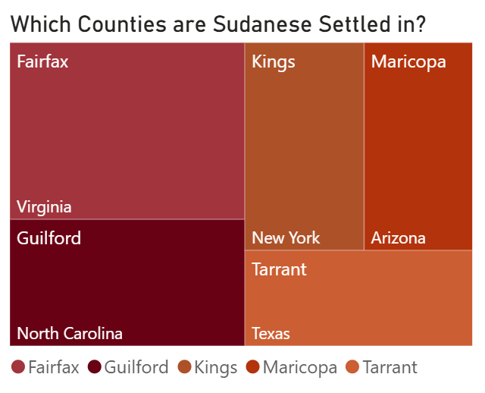
Top 5 Counties of Sudanese settlers

Slide 10
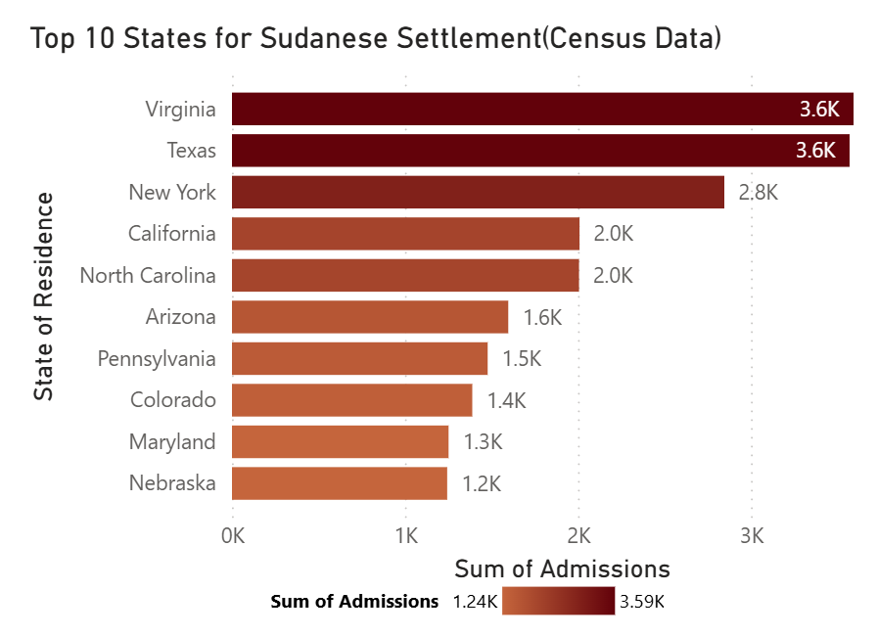
Virginia, Texas, and New York are the leading states as per the Census. This could be due to 2nd resettlement.

Slide 11
Reasons for possible settlement:
After reaching their entry points, many families often resettle. Some within the first year, moving to areas that have more manufacturing jobs, affordable housing, cultural resources, strong social support, and often climate familiarity.

Slide 12
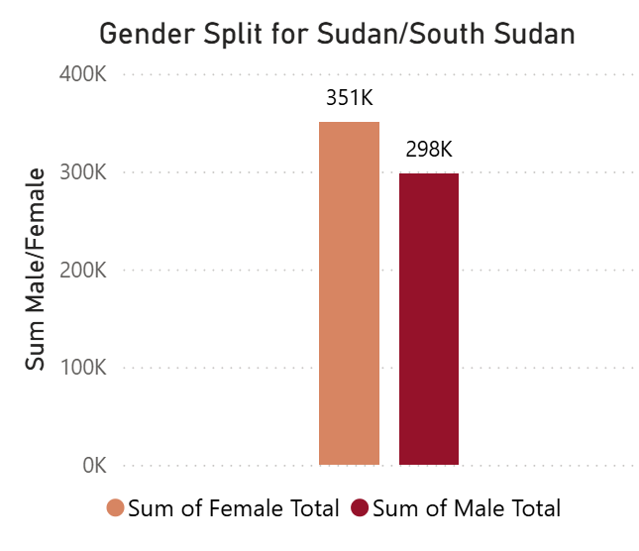
Who is being admitted(UNHCR)?

Slide 13
Why is it that there is a larger number of females to males.
Majority of Sudan and South Sudan armed forced are made up of men. Most of the women serve in logistics, medical, of signal roles. So that leaves the men to fight in the frontlines.
Males young and old are targeted to eliminate potential resistance, while females are more are more subject to sexual violence.
Which may be the reason to why you see more migration of females, or families with just the mother.

Slide 14
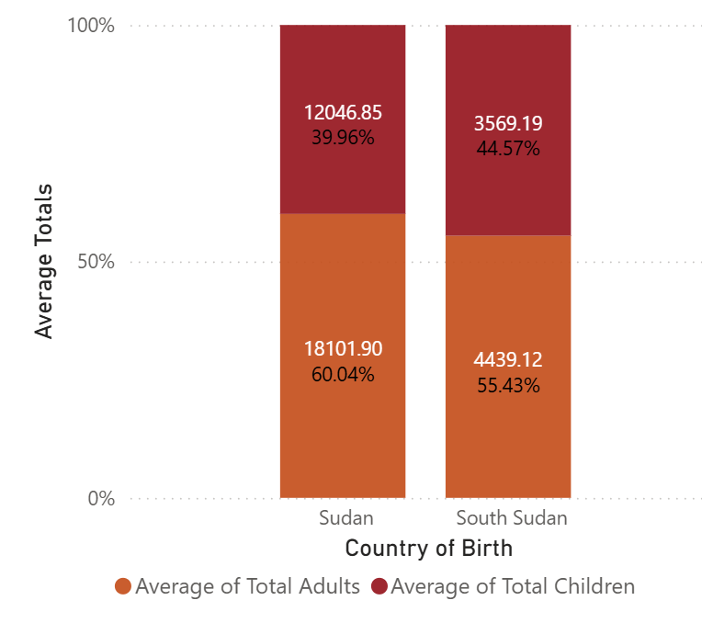
What is their gender makeup?

Slide 15
Summary
This project analyzes the displacement and resettlement of Sudanese communities in the United States from 2001 to 2024. Inspired by my own journey from Sudan to Egypt and then to the U.S., it examines why people flee and where they settle, highlighting major hubs in Virginia, Texas, and New York.
Next Steps: Future research will focus on tracking Sudanese movement through Egypt transit route and studying secondary migration within the United States to places like Omaha, Nebraska, Des Moines Iowa, & Nashville, Tennessee.

Slide 16
Q&A
Thank you!

